Slide 1
Lecture 16 What’s Next
Instructor: Chien-Ju (CJ) Ho

Slide 2
Logistics: Project Milestone 2
Milestone 2: Due Nov 4
Summarize your progress
Should make enough progress to know whether the project is feasible
Last chance to convert a research project to an extensive literature survey
Midterm Pitch: Nov 1 (Tue), in lecture
Opportunity to engage other classmates
Format
Every team gives a 1-min elevator pitch about their projects
Data collection: 3 teams will perform data collection
Group discussions
Three big groups, with 3~4 teams per group
Each team gets ~10 minutes of time from other teams
Everyone is expected to attend

Slide 3
Logistics: Midterm Project Pitch
Time: Next Tuesday
What to do beforehand
Prepare a 1-page slide and send it to me
Send me the slides via email by noon next Tuesday
Prepare a 1-min elevator pitch about your project
Think about how to utilize the discussion time
Let me know by today if you plan to engage the entire class

Slide 4
Logistics: Presentations and Peer Reviews
Common suggestions in the peer reviews
Engage the audience more
eye contact
be enthusiastic
pace control
Succinct slides and visual aids are usually preferred

Slide 5
Lecture Today
Recap of what we have discussed so far
Introduce what we will discuss in the next few lectures
Discussion on related topics that are not covered in this course

Slide 6
What We Have Discussed So far
Human-in-the-Loop Computation: From Task Solvers’ Perspective

Slide 7

From Task Solvers’ Perspective
Tasks
Output
Microtasks
Flower
Dog
Cute
…

Slide 8
From Task Solvers’ Perspective
Tasks
Output
Key Challenge: How To Ensure Output Quality
Human as data sources:
Label aggregation
Probabilistic reasoning to aggregate noisy human data
Humans are “Humans”:
Incentive design
Game theoretical modeling of humans and incentive design

Slide 9
From Task Solvers’ Perspective
Tasks
Output
Practical challenges: Real-time, non-independent work, complex tasks

Slide 10
(From Lecture 1) What is this course about?
Study the design and analysis of human-in-the-loop computation.
Human as data sources:
Label aggregation
Probabilistic reasoning to aggregate noisy human data
Practical challenges:
Real-time and complex tasks
Studies on workflow and team designs from HCI perspective
Humans are “Humans”:
Incentive design
Game theoretical modeling of humans and incentive design

Slide 11
Crowdsourcing and Human Computation
Human-in-the-Loop Computation

Slide 12
Remaining Lectures: Focus on Human-AI Interactions
Fairness in AI (Nov 3, 8)
Are the decisions made by AI fair to humans involved?
Ethical decision making and participatory design (Nov 10)
Can we, and how can we, ask humans to help AI make ”ethical” decisions
Strategic machine learning (Nov 15)
What if humans who generated data are influenced by the outcome of AI?
Interpretable machine learning (Nov 17)
How to make the predictions by AI understandable by humans
Human-AI Collaboration (Nov 29 and Dec 1)
Can we team up humans and AI to solve tasks together?

Slide 13
(From Lecture 1) What is this course about?
Study the design and analysis of human-in-the-loop computation.
Human as data sources:
Label aggregation
Probabilistic reasoning to aggregate noisy human data
Practical challenges:
Real-time and complex tasks
Studies on workflow and team designs from HCI perspective
Humans are “Humans”:
Incentive design
Game theoretical modeling of humans and incentive design
Selected recent topics:
Ethical issues of AI/ML, learning with strategic behavior, Human-AI collaborations.
The focus of the next seven lectures!

Slide 14
An Emerging Research Agenda on AI/ML + Humans/Society
WashU Division of Computational and Data Sciences
PhD program hosted by CSE, Political Science, Social Work, Psychology and Brain Science
Stanford Institute for Human-Centered Artificial Intelligence
MIT Institute for Data, Systems, and Society
CMU Societal Computing
USC Center for AI in Society

Slide 15
Before we move on…
Required Reading:
Mathematical Foundations For Social Computing.
Yiling Chen, Arpita Ghosh, Michael Kearns, Tim Roughgarden, Jennifer Wortman Vaughan.
Communications of the ACM. 2016

Slide 16
Crowdsourcing Compiler
Crowd
+ AI
Goal
Result
Understanding humans, developing realistic human models, and incorporating them into the computation framework.
Multidisciplinary in nature
Machine Learning
Economics Theory
Computational Social Science
Optimization
Human-Computer Interaction
and more…

Slide 17
Warm-Up Discussion
What do you think are the top challenge(s) in designing/implementing the crowdsourcing compiler?
For crowdsourcing to be sustainable, we need people to be willing to be part of it. What do you think are the important components we can/should/might add for crowdsourcing to enable a real career (e.g., adding career development, skill training, social support, etc)?

Slide 18
Brief Discussions on Topics that We Won’t Cover

Slide 19
Beyond Solving Objective Tasks
Fair division among the crowd
Crowd research: open and scalable lab
Crowdsourcing democracy
Incentives in Blockchain

Slide 20
Fair Division (Resource Allocation)
Classical example:
How to fairly split (fair: envy-free) the cake among two people?
General research question:
How to design mechanisms to allocate resources with “good” properties
participants truthfully report their preferences
no one is envy of others

Slide 21
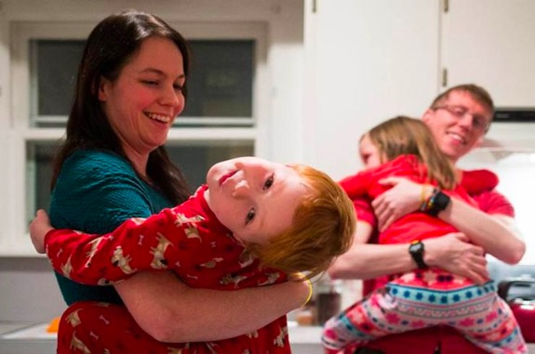

Fair Division
Who should do the household chores
Essentially a second-price auction:
Each “bid” how much she/he thinks the work is worth
High bidder pays the amount the low bidder bids
Low bidder does the work and gets paid

Slide 22
Fair Division
Spliddit
How do we allocate payments / credits to workers who work together for a complex task?
What are the ”good” properties we want to achieve
How to design algorithms to achieve that?
Fair division / resource allocation on societal issues
How do we allocate “donated organs” to patients who need them?
How do we allocate government resources to homeless people?
How do we allocate COVID vaccines to people.

Slide 23
Crowd Research: Scalable and Open Lab
Most research projects are done by small groups of researchers
Can we scale up research as well?
Success story:
Polymath project: Collaborative Math Problem Solving
Published papers under the pseudonym D.H.J. Polymath.
Majority of contributions are done by a few
Timothy Gowers (U Cambridge)
Terence Tao (UCLA)
Many have made solid contributions
The Polymath Project: Lessons from a Successful Online Collaboration in Mathematics. Cranshaw and Kittur. CHI'11

Slide 24
Crowd Research: Scalable and Open Lab
Incorporating diverse thoughts / skills
1500 participants from 62 countries for 3 research projects
Crowd Research: Open and Scalable University Laboratories. Vaish et al. UIST 2017.

Slide 25
Crowd Research: Scalable and Open Lab
Incorporating diverse thoughts / skills
1500 participants from 62 countries for 3 research projects
Enabling research opportunities to students in less resourceful institutions

Slide 26
Crowd Research: Scalable and Open Lab
Challenges
How to maintain the research progress?
How to distribute the credits?

Slide 27
Crowd Research: Scalable and Open Lab
Outcome:
A couple of work-in-progress reports
Two top-tier conference papers (UIST’16, CSCW’17)
Recommendation letters are provided to participants with significant contributions for graduate school applications

Slide 28
Crowdsourcing Democracy
Democracy is a crowdsourcing process
Vote for a leader to make decisions
Vote to determine the policy through referendum
And more
Is the crowd always wise?
256 | 649 | 900 | 1296
350 | 650 | 978 | 1500
375 | 700 | 1000 | 1700
387 | 720 | 1008 | 2000
455 | 730 | 1024 | 2100
494 | 739 | 1028 | 2500
519 | 800 | 1200 | 2500
550 | 800 | 1200 | 3000
625 | 847 | 1232 | 10,000
625 | 899 | 1250 | 102000
Mean: 3789.65
Median: 899.5
True Answer: 721

Slide 29
Crowdsourcing Democracy
Helping the crowd to make more informed decisions
E.g., enabling information exchange, deliberation
Potential issues to be careful about
Fake news – Misinformation
Polarization in social networks

Slide 30
Human-in-the-Loop Computation: From Machine Learning Perspective

Slide 31
Machine Learning Lifecycle
Feedback
Task Definition
Deployment
Dataset Construction
Testing
Model Definition
Training

Slide 32
Machine Learning Lifecycle
Feedback
Task Definition
Deployment
Dataset Construction
Most ML research
Testing
Model Definition
Training

Slide 33
Machine Learning Lifecycle
Feedback
Task Definition
Most topics in this semester
Deployment
Dataset Construction
Most ML research
Testing
Model Definition
Training

Slide 34
Machine Learning Lifecycle
Humans can be involved in every aspect of the process
Feedback
Task Definition
Most topics in this semester
Deployment
Dataset Construction
Most ML research
Testing
Model Definition
Training

Slide 35
Machine Learning Lifecycle
Feedback
Task Definition
Are we being fair to humans?
Deployment
Dataset Construction
Is there privacy leak?
Testing
Model Definition
Training

Slide 36
Discussion on Privacy

Slide 37
Netflix Challenges
First Netflix challenge
Announced in 2006
Released a dataset of 100,480,507 ratings that 480,189 users gave to 17,770 movies.
Award $1 million to first team beating their algorithm by 10%
Data format: <user, movie, date of grade, grade>
User and movie names are replaced with integers
Is there a second Netflix challenge?
Announced in August 2009
Cancelled in March 2010
Why?
Privacy lawsuits and FTC involvements

Slide 38
Netflix Dataset
IMDB Data

Slide 39
Why is Anonymization Hard?
Even without explicit identifiable information (e.g., ID, name), other detailed information about you might still reveal who you are
What can we do?
Adding noises
Tradeoff between privacy and utility

Slide 40
Another Example
Matchin: A Game for Collecting User Preferences on Images
Building gender models using user labels
Ask MTurk workers to compare 10 pairs of images.
Accuracy for guessing the gender: 78.3%

Slide 41
Unreasonable Privacy Expectations
Can we get privacy for free?
No, privatizing means information loss (=> accuracy loss)
Absolute privacy is not likely.
Who you are friends with might reveal who you are

Slide 42
(Maybe) More Reasonable Expectations
Quantitative
Want a knob to tune the tradeoff between accuracy and privacy loss
Plausible deniability
Your presence in a database cannot be ascertained
Prevent targeted attacks
Limit information leaked even with side knowledge

Slide 43
Differential Privacy
A formal notion to characterize privacy.
History
Proposed by Dwork et al. 2006
Win the Gödel Prize in 2017
Apple announced to adopt the notion of differential privacy in iOS 10 in 2016

Slide 44
Differential Privacy

Slide 45
Differential Privacy
Assume we have an exam in this course. And I have distributed this score distribution.
How much of the private information (your individual grades) do I reveal?
What if there are only 2 students in the class?

Slide 46
Differential Privacy

Slide 47
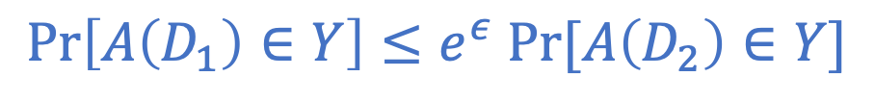
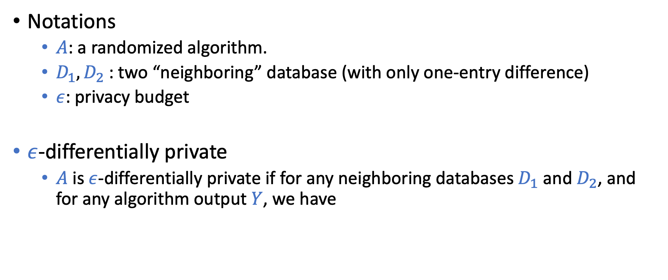
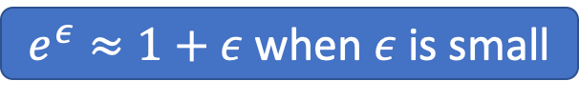
Differential Privacy
Notations
$A$: a randomized algorithm.
$D_{1}, D_{2}$: two “neighboring” database (with only one-entry difference)
$ε$: privacy budget
$ε$-differentially private
$A$ is $ε$-differentially private if for any neighboring databases $D_{1}$ and $D_{2}$, and for any algorithm output $Y$, we have
$$\operatorname{Pr}\left[A\left(D_{1}\right)∈Y\right]≤e^{ε} Pr⁡[A\left(D_{2}\right)∈Y]$$
Intuition: The change of output is small if the change of data is small
$e^{ε}≈1+ε$ when $ε$ is small

Slide 48
How to Be Differentially Private
Let the output of A be the average of users’ ages
Consider two extreme cases
If the size of the database is 1
If the size of the database is infinity
Add noise
We can tune the amount of noise to tradeoff privacy and accuracy
A majority of the differentially private algorithms use a similar approach

Slide 49
Discussion
Differential privacy is a formal tool that we can tune the privacy budget to tradeoff privacy and utility/accuracy.
We have been giving the big tech companies a lot of information. Have you been worried about any of the privacy issues? What’s the line you will choose privacy or utility?

Slide 50
Fairness

Slide 52
Isn’t the point of ML to discriminate?
Want to avoid “unjustified” discrimination.

Slide 53
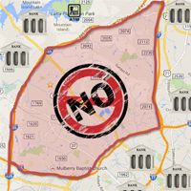
Example: Loan Applications
By law, the banks can’t discriminate people according to their race.
First natural approach (fairness through blindness)
remove the race attribute from the data
Guess what happened?
Redlining

Slide 54
What should we do?
From computer scientists / engineers’ point of view….
Give me an operational definition of fairness, I’ll implement a system that satisfy it!
How should we define fairness? Is it even possible to define an universal fairness notion?
More in the next few lectures.

Slide 55
Incentives in Blockchain

Slide 56
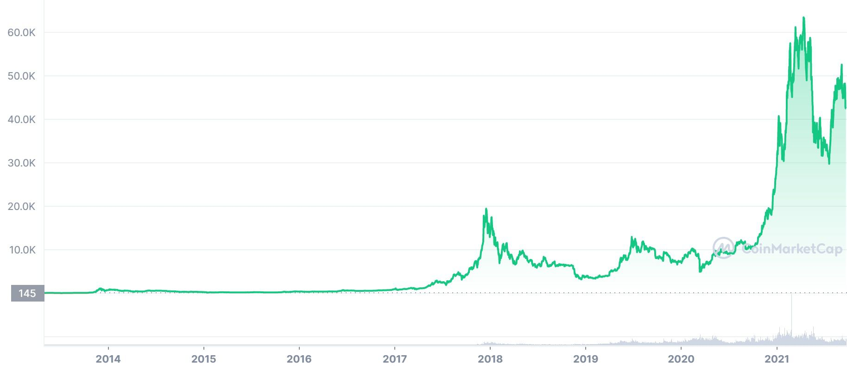
Blockchain
Famous example: Bitcoin

Slide 57
Blockchain
Properties of traditional currency systems
A centralized mechanism
Relies on trust on the currency issuer
Book-keeping is maintained by the center
The bank / Paypal are maintaining the transaction history / ledger
Single point of failure
Blockchain
A decentralized protocol of maintaining the ledger

Slide 58
How does Blockchain Work
We’ll use bitcoin as the example
Everyone is in a peer-to-peer network
Whenever a transaction happens, the transaction is broadcast to the network
Main question:
How do we maintain a ledger (transaction history) that is immutable and the same for every participant?

Slide 59
How does Blockchain Work
Maintain the ledger in a chain of blocks (hence, blockchain)
What’s in each block?
Transactions:
A gives B 0.15BTC
B gives C 0.21 BTC
…
How to maintain the block chain?
If there is a center
The center just appends the transaction record to the end whenever it happens
How should we do this without the center?
Hash of previous block
A nonce (more later)

Slide 60
How does Blockchain Work
Who can generate the blocks?
Everyone can generate the blocks
How are blocks generated?
Proof of Work
Transactions:
A gives B 0.15BTC
B gives C 0.21 BTC
…
A block is valid if the first L digits of the hash of the block is 0.
L is tuned such that a new block is generated roughly every 10 minutes
Miner:
Keep change the nonce value, until finding a valid block
Hash of previous block
A nonce (more later)

Slide 61
Why Miners Mine?
Monetary incentives
The miner gets some amount of bitcoins for each valid block
The amount is decreasing and will eventually go to 0
The miner gets transaction fees for transactions included in the block
So far, the miner incentive is mainly driven by the bitcoin of new block
It is expected that the transaction fees will be more important in the future
A higher transaction fee might lead to faster inclusion of the transaction
Design of transaction fees could be an interesting topic

Slide 62
How does Blockchain Work
Protocol of Blockchain
Users with transactions
Announce transactions in the network
Miners pick up the transactions not in the ledger
Keep change the nonce until finding a valid block
Attach the block to the end of the ledger
What if there are multiple branches (forks?)
Transactions:
A gives B 0.15BTC
B gives C 0.21 BTC
…
Hash of previous block
A nonce (more later)

Slide 63
How does Blockchain Work
How to resolve conflicts (fork)
Intuition:
Majority voting
But online fake identity is easy to create……
Majority voting, weighted by your computation power!
Protocol: Recognize the longest chain

Slide 64
How does Blockchain Work
Protocol of Blockchain
Users with transactions
Announce transactions in the network
Miners pickup the transactions not in the ledger
Keep change the nonce until finding a valid block
Attach the block to the end of the ledger
What if there are multiple branches (forks?)
The longest branch is the valid one
Kinda like majority voting weighted by computational power
Transactions:
A gives B 0.15BTC
B gives C 0.21 BTC
…
Hash of previous block
A nonce (more later)
Incentive properties:
If your computational power is small compared with the total, and if everyone else is following the protocol, you should follow the protocol.

Slide 65
Common Claim
The ledger in Blockchain is immutable and cannot be altered
Not really true!
Incentive properties:
If your computational power is small compared with the total, and if everyone else is following the protocol, you should follow the protocol.

Slide 66
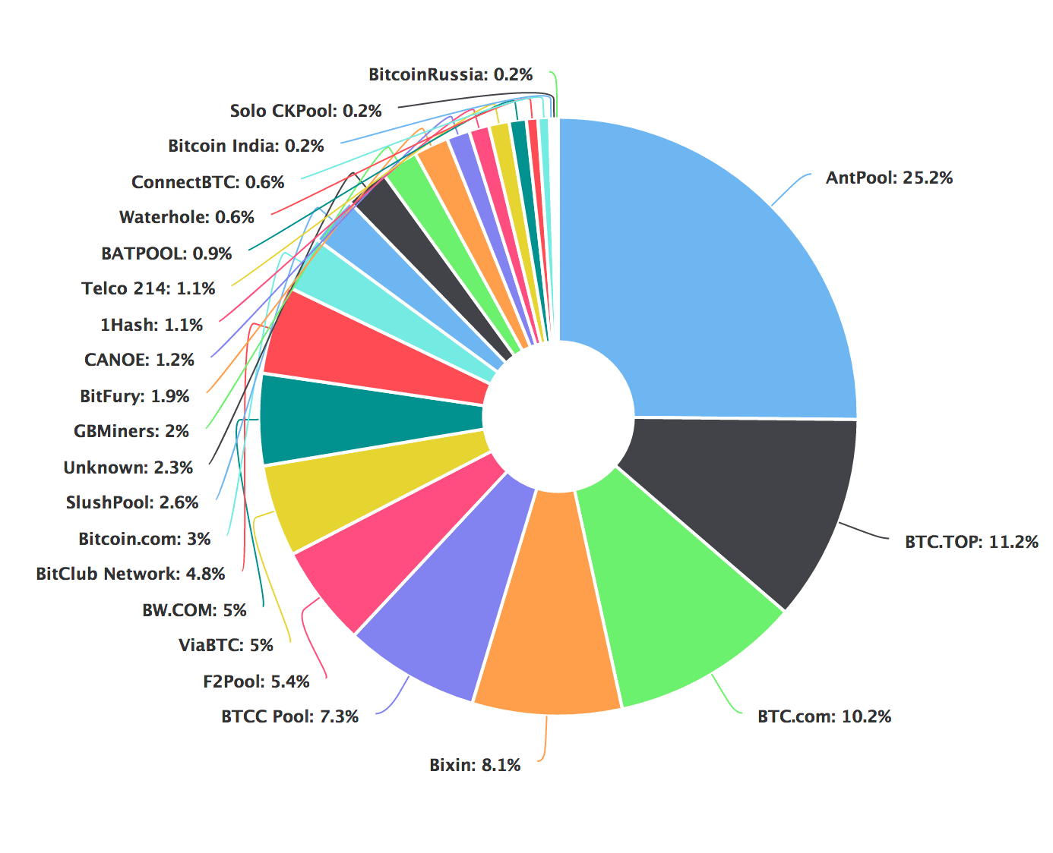
51% Attack
Say a miner has more than 50% of the computation power
If the miner keeps mining blocks (and hide it), eventually will grow a chain that is longer than the current one
The miner can then attach the chain and invalidate the current block chain.
In fact, there are more sophisticated attack that only requires 33% of computational power.
It might not be impossible to achieve 33%, as people usually pool their computational resources together to decrease the risk

Slide 67
Main Criticism of Blockchain
A huge waste of electricity and computational resources
Replacing proof of work by other concepts
In intuition, still use majority voting but weighted by different factors
Proof of Stake
Weighted by the amount of ”currency”
Hope: People who own more are likely to be protective of the current system and do not abuse

Slide 68

More than Digital Currencies
Non-Fungible Token (NFT)
Digital Pets on Blockchain
Some discussion on performing distributed computation on blockchain

